Slide 1


Lecture 3
Logical Indexing

Slide 2
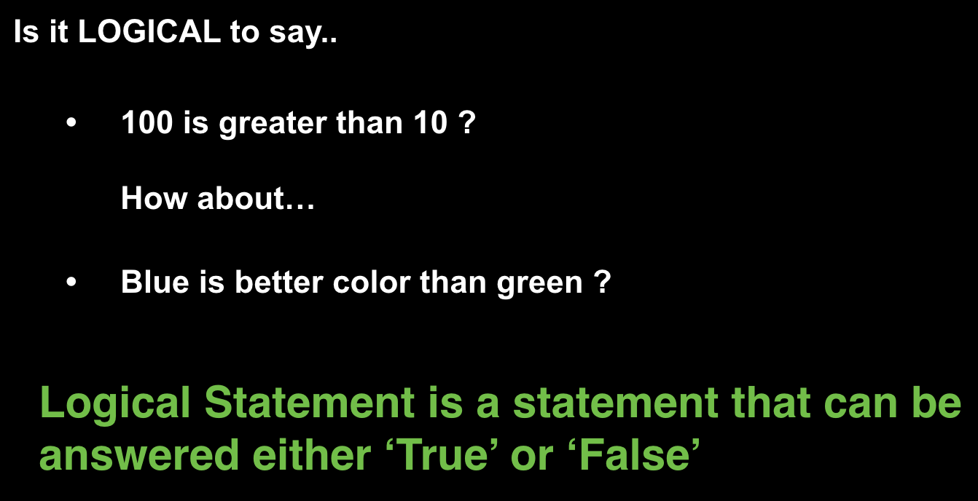
Logical Variable

Slide 3
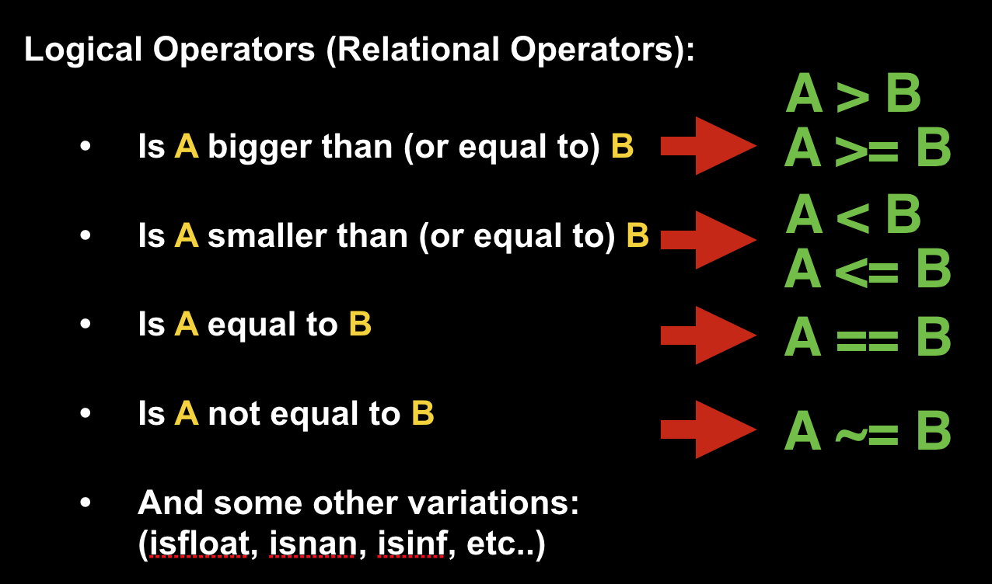
Logical Variable

Slide 4
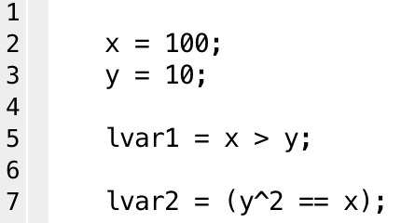
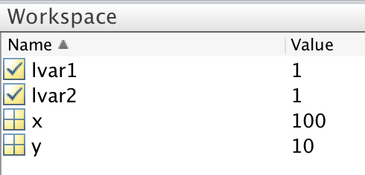
Logical Variable
Logical(Boolean) Variable
Variable that holds either ‘True’ or ’False’
Can be defined using logical statements

Slide 5
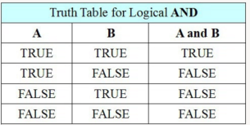
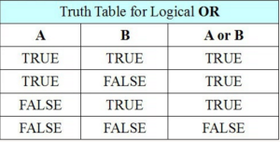
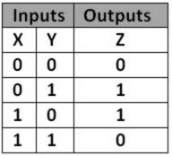
Logical Variable
Logical Operation
A = xor(X,Y)

Slide 6
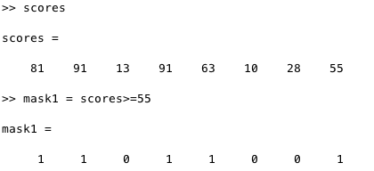
Logical Variable
Logical Array
Logical statement applied to arrays (vector / matrix)
Each logical statement is evaluated for each element

Slide 7


  Presenter Name | Department or School Name | Date
LOGICAL ARRAY can be directly passed into indexing
and serve as a MASK to pin-point the desired element
vec1 =
vec1>0 =
1 | 0 | 0 | 1 | 0
vec1(vec>0) =
5 | 100

Slide 8
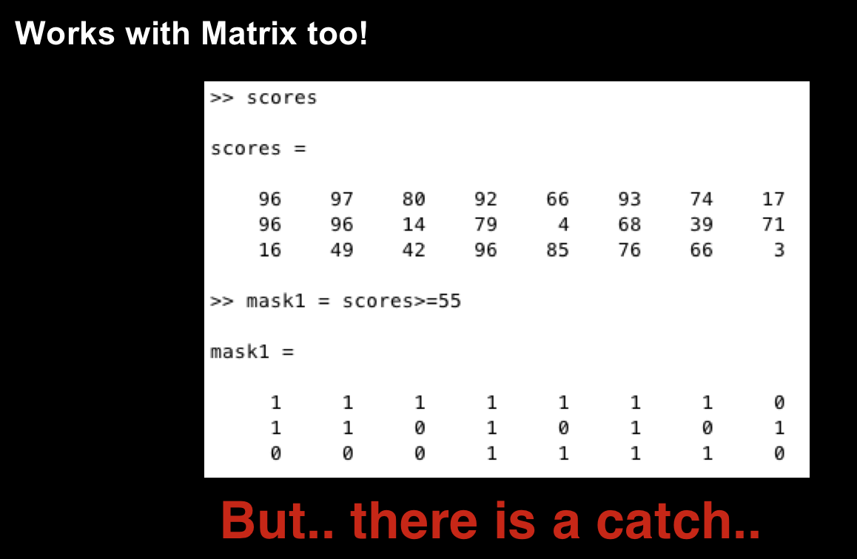
Logical Variable

Slide 9
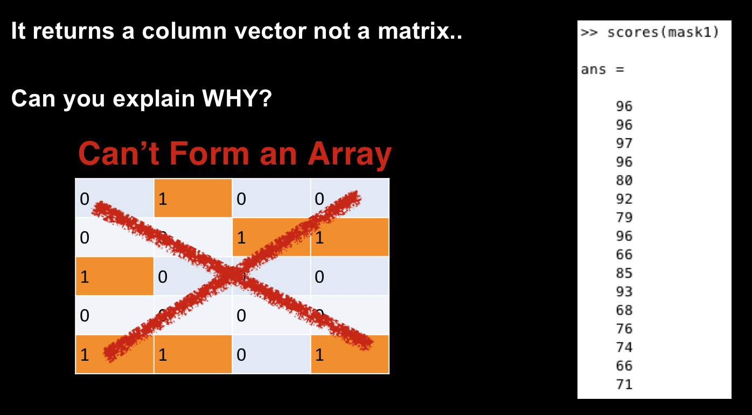
Logical Variable

Slide 10
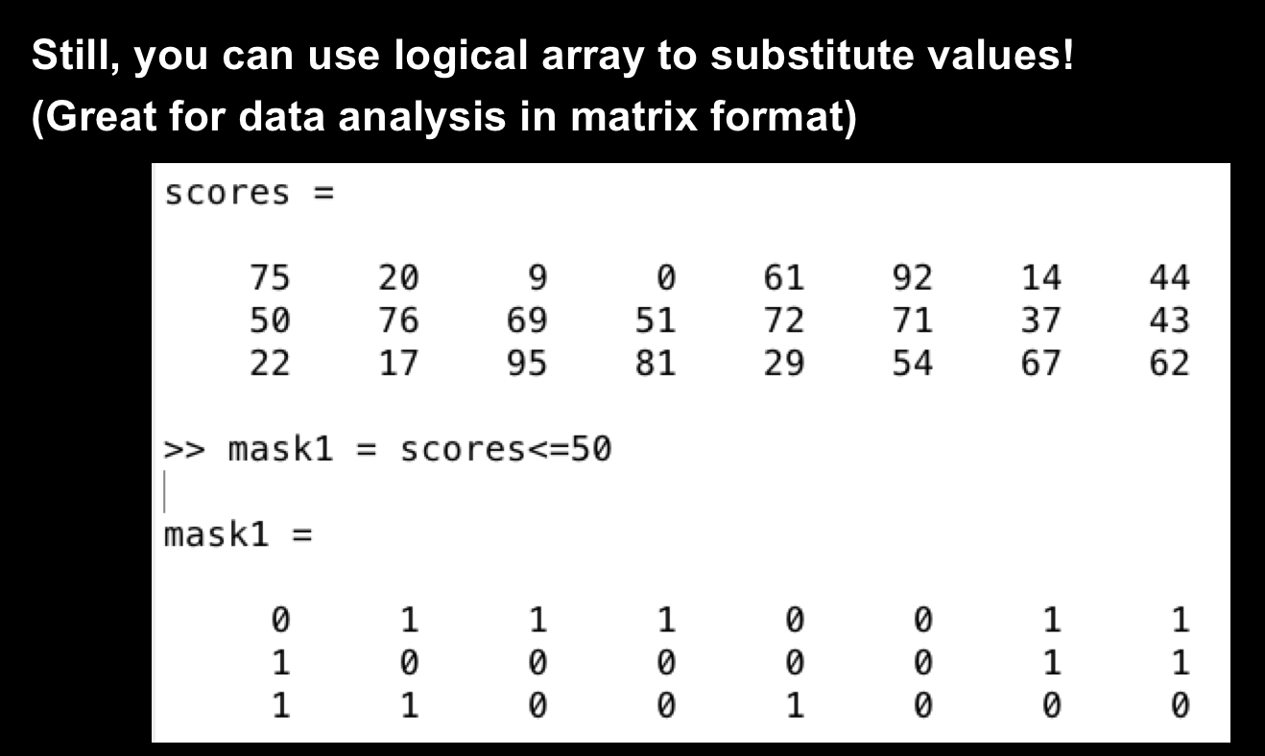
Logical Variable

Slide 11
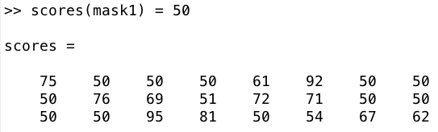
Logical Variable

Slide 12
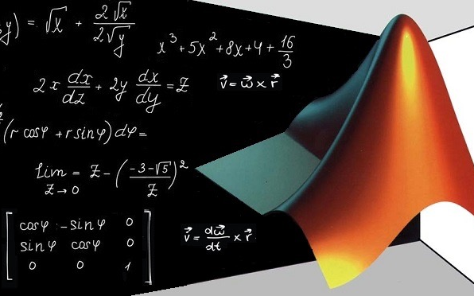
Sum, mean, max/min
Presenter Name | Department or School Name | Date

Slide 13
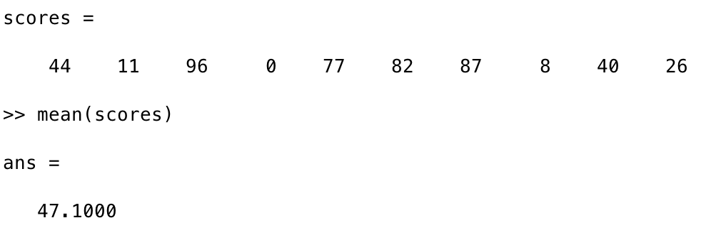
  Presenter Name | Department or School Name | Date
mean
  Computes mean for given vector

Slide 14
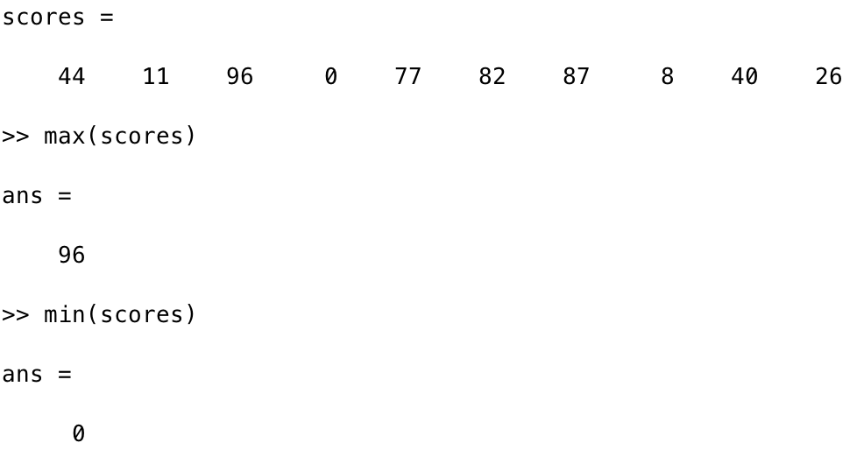
  Presenter Name | Department or School Name | Date
max, min
  Returns maximum / minimum element in a vector

Slide 15
  Presenter Name | Department or School Name | Date
With different syntax, max/min function also returns the index of the max(min) element
Very USEFUL tool!!
[val, idx] = max(scores)
Doesn’t have to be
these names!

Slide 16
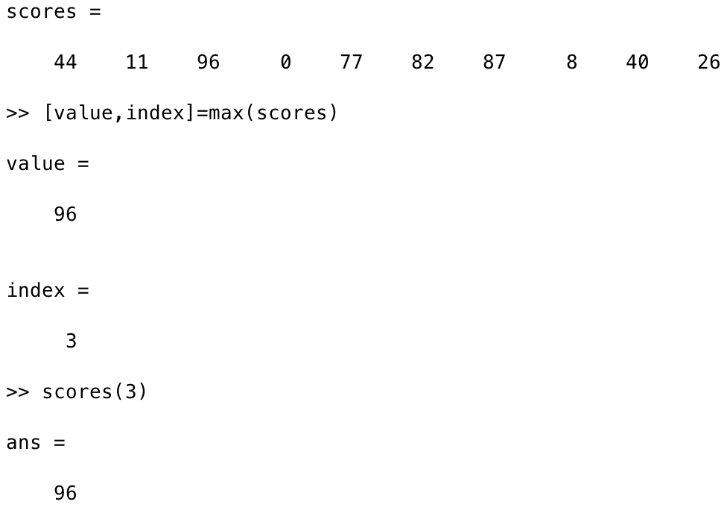
  Presenter Name | Department or School Name | Date

Slide 17
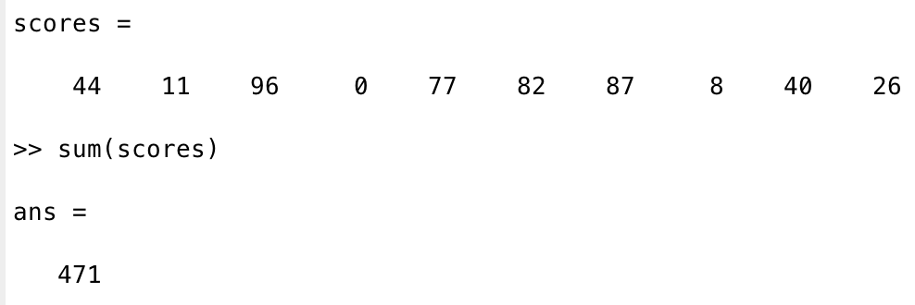
  Presenter Name | Department or School Name | Date
sum
  Add all the elements in a vector

Slide 18
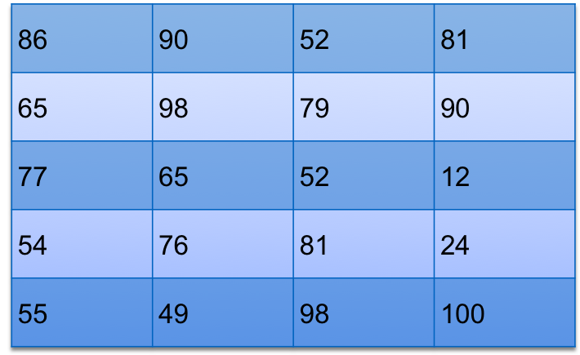
  Presenter Name | Department or School Name | Date
Now.. for a matrix, let us think about for a second!
Say you are summing the elements in a matrix!
Which way would you sum them up to?
scores =

Slide 19
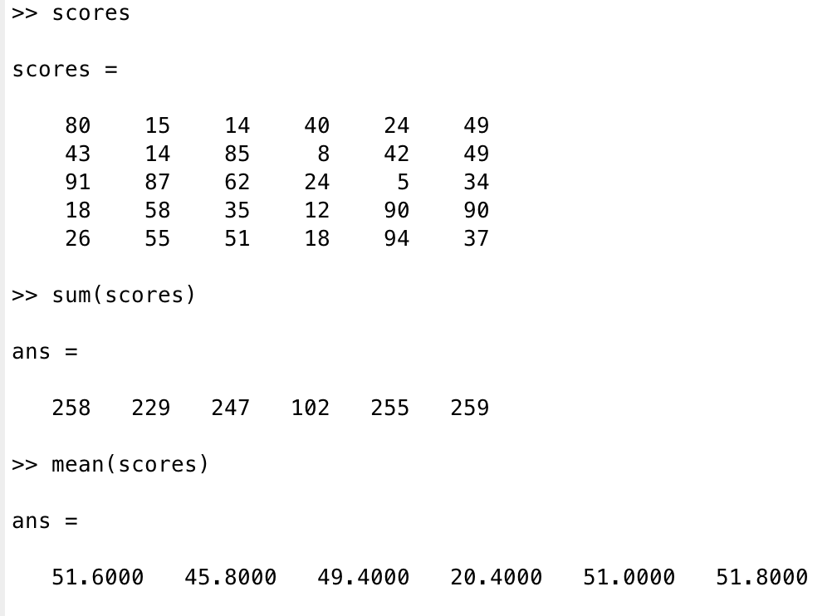
  Presenter Name | Department or School Name | Date
By default, sum & mean function are computed column-wise!

Slide 20
  Presenter Name | Department or School Name | Date
However, there IS a way to compute sum and mean in row-wise
with different syntax:
With omitted option, MATLAB, by default, compute these with Axis = 1 or Dim = 1
Note: max / min does not support this option
mean(scores, 2)
Option!
(Axis or Dim = 2)

Slide 21

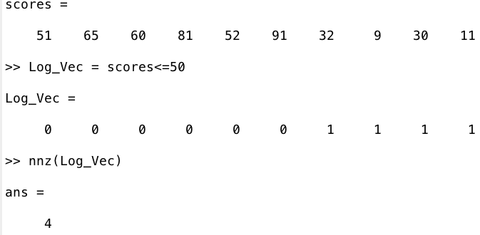
Logical Variable

Slide 22
Class Exercise
Create a matrix using following lines:
1st row: Student ID number
2nd ~ 4th row: Scores for midterm 1, 2 and Final
Find how many students scored less than 50 on Mid-term 1
Identify the students (ID) who scored higher than 90 on Mid-term 2
Identify the students(ID) who should receive ’A’ grade
The ‘A’ grade should be assigned for students with the total score higher than 90.
Total-score = (0.3 * midterm1) + (0.3 * midterm2) + (0.4 * final)

